Slide 1
2. Customer Platform
ADVANCED
OPERATIONS
TRAINING
© Copyright Scality 2022
RING 8.5

Slide 2
Customer Platform
At the end of this module, you will be able to …
… access the main management interfaces
… find and list your RING platform specifications.
Notes:
Last update: 20180410

Slide 3
Contents
Management Interface Access
Browser Compatibility
Connecting to the GUI
Customer Architecture
Hardware
System
Software

Slide 4
Accessing Management Interfaces
RING 8.5

Slide 5
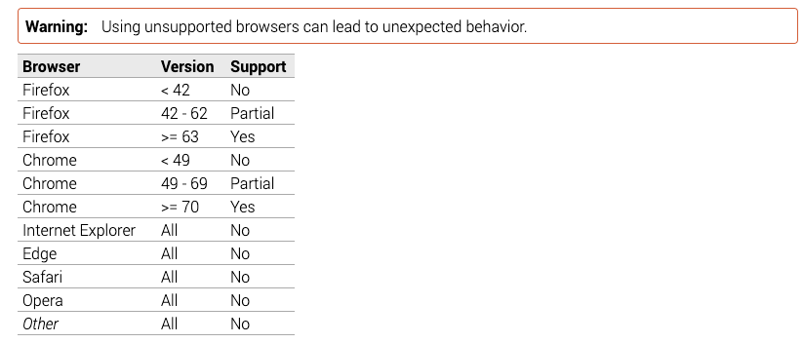
Browser Compatibility
Firefox 63 released in June 2018
Chrome 70 released in October 2018

Slide 6
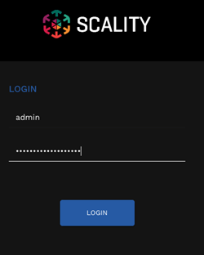
Connecting to the Supervisor GUI (Demo)
https://<Supervisor-IP-or-hostname>
Default username: admin.
Password set during RING installation.
Shortcuts:
RING Administration Interface: https://<Supervisor-IP-or-hostname>/sup
S3 Console: https://<S3-endpoint-IP-or-hostname>/_/console/
Grafana: https://<Supervisor-IP-or-hostname>/stats

Slide 7
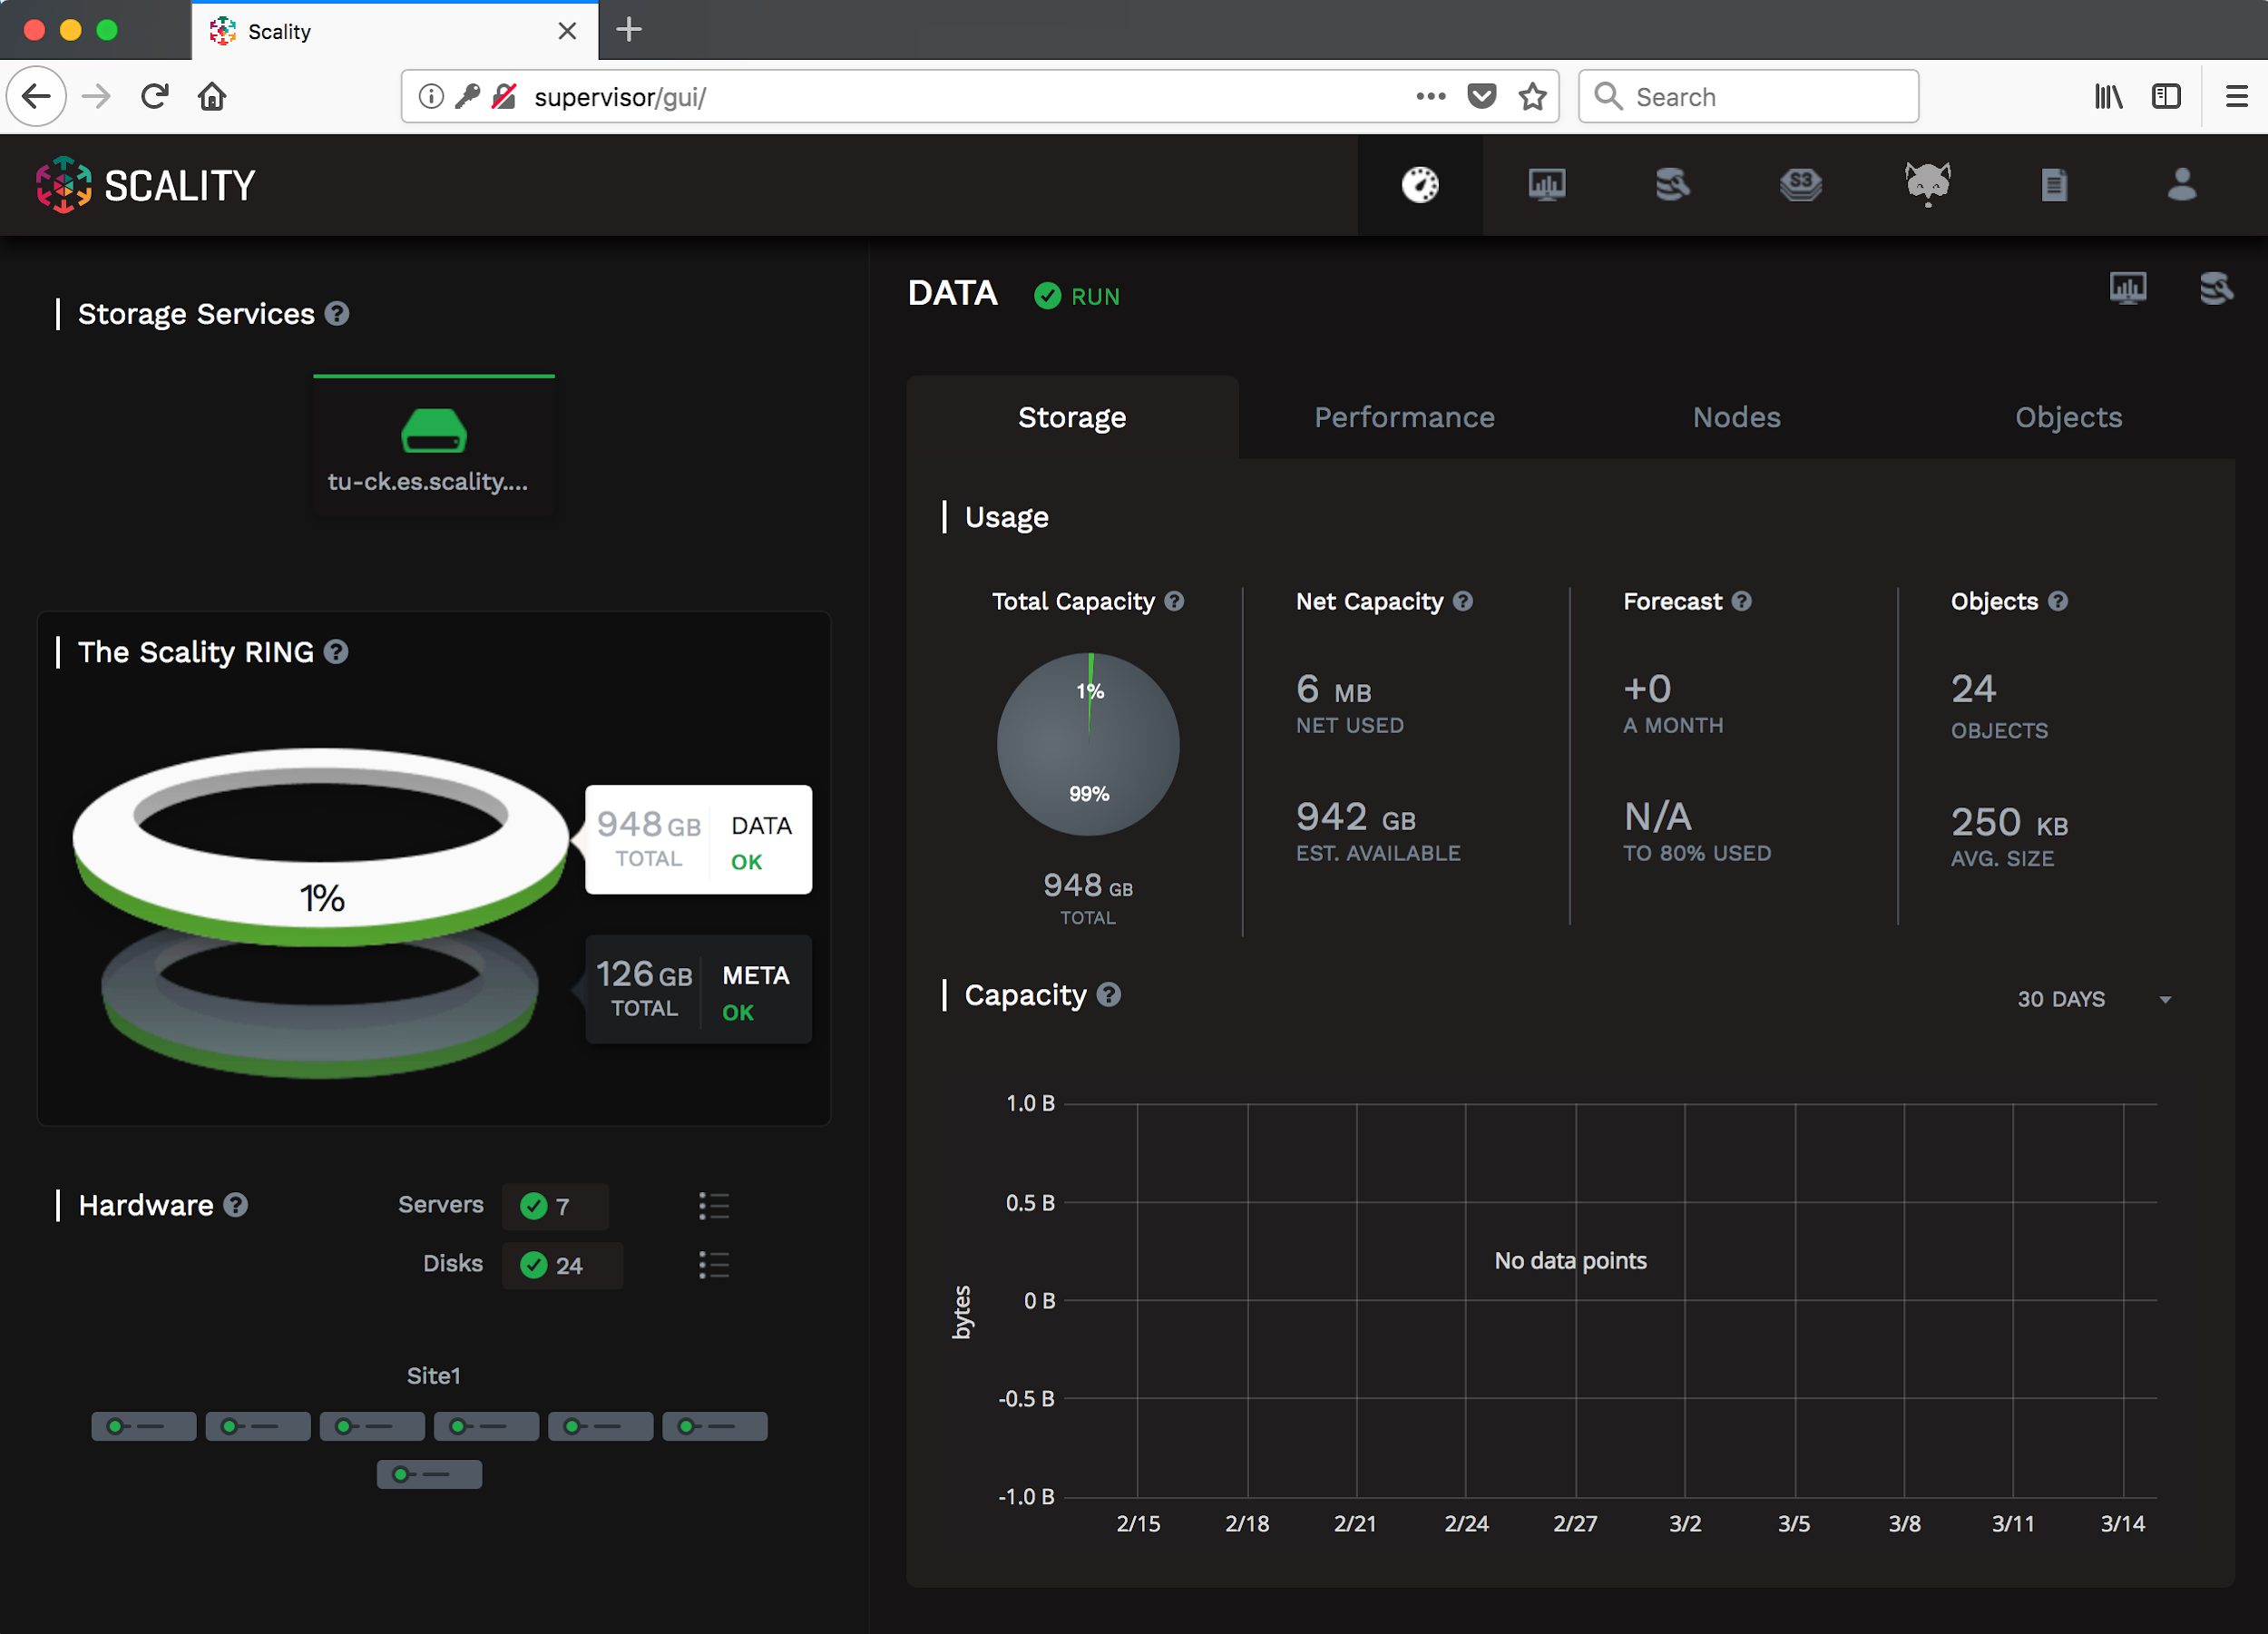
The Supervisor (Demo)

Slide 8
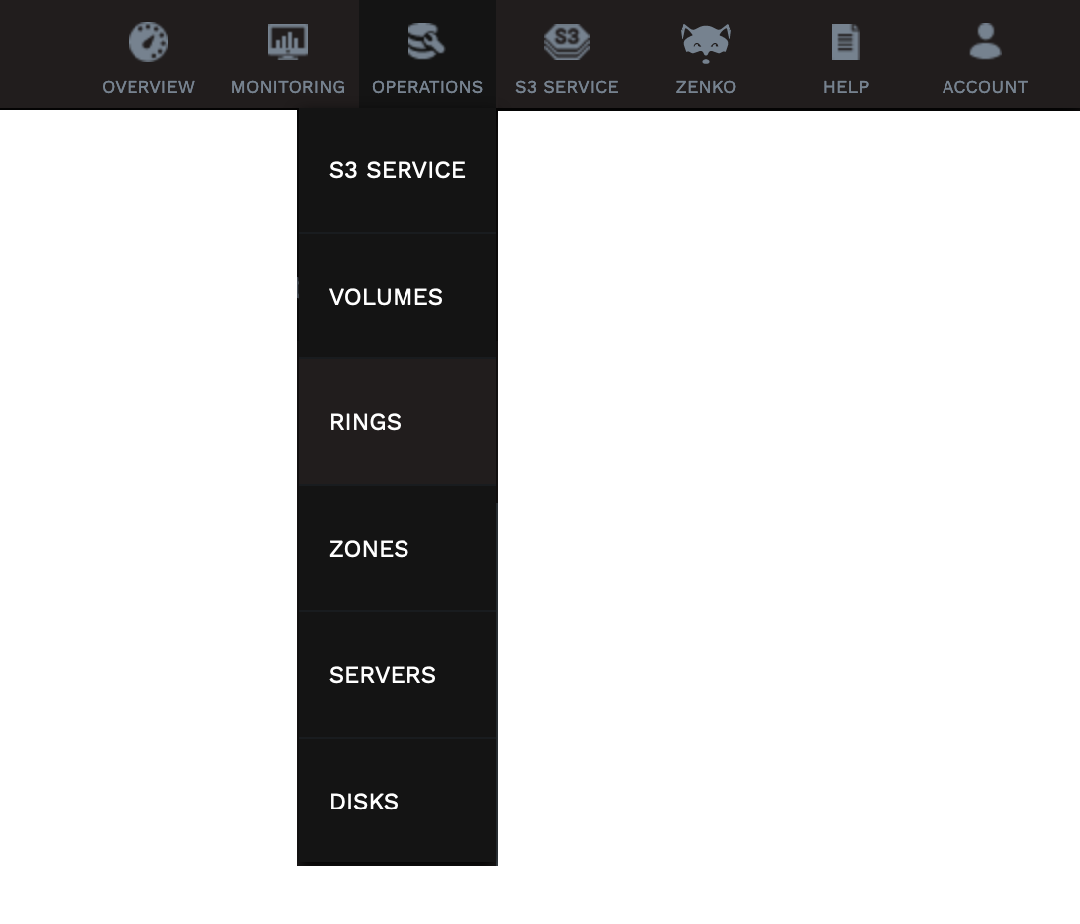
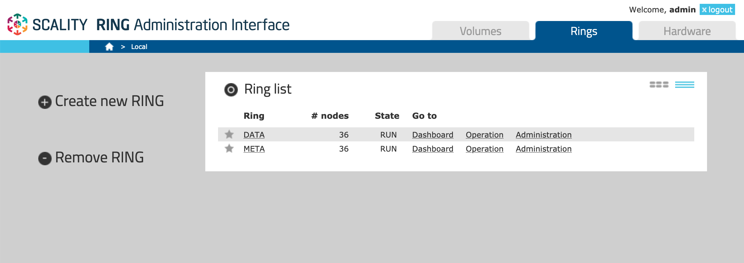

The RING Administration Interface (Demo)

Slide 9
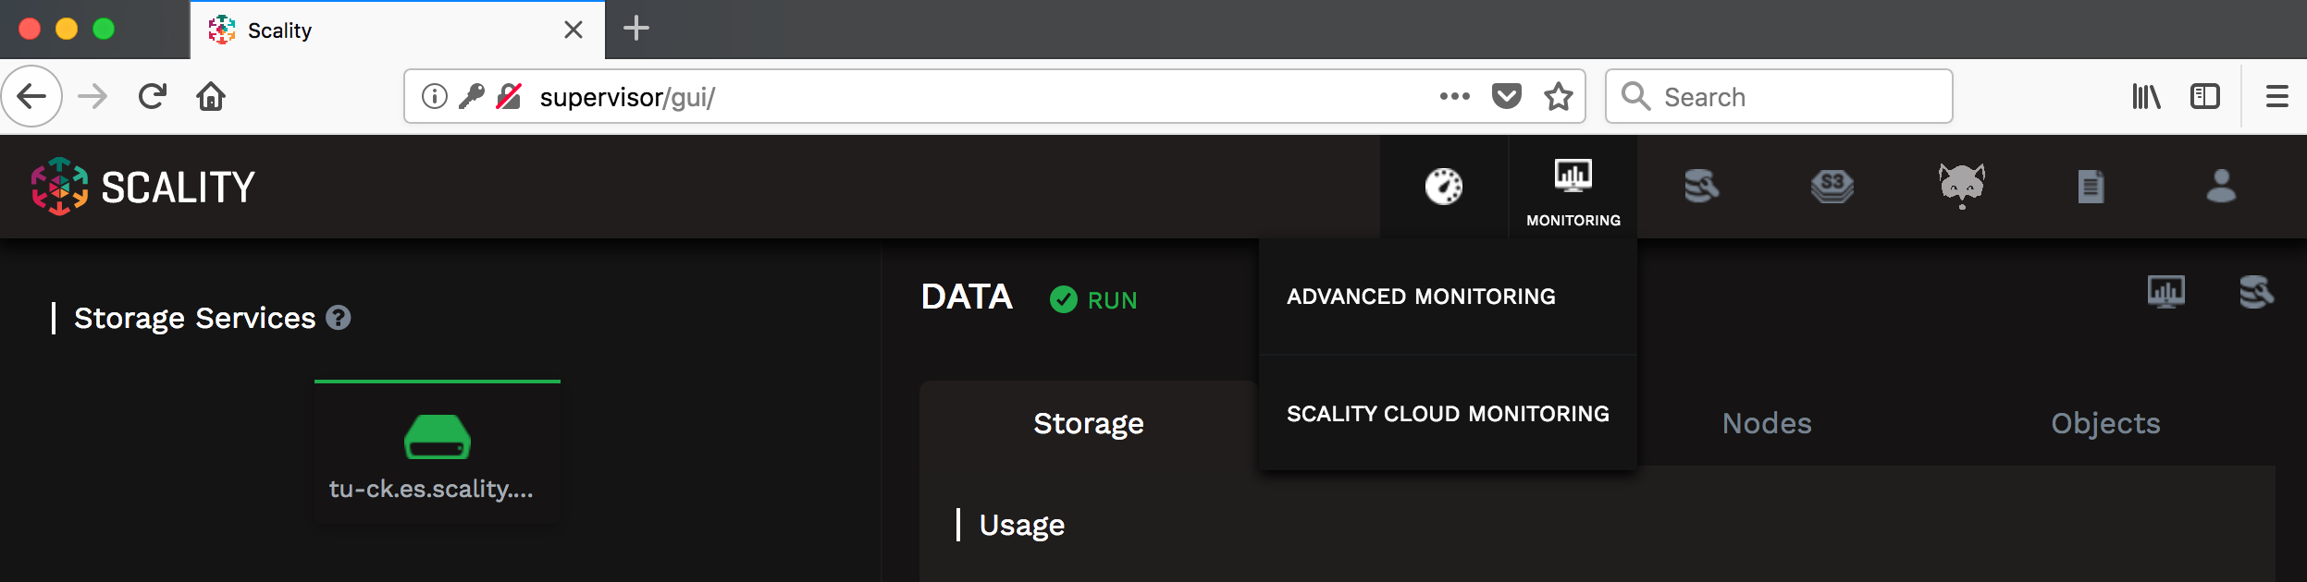
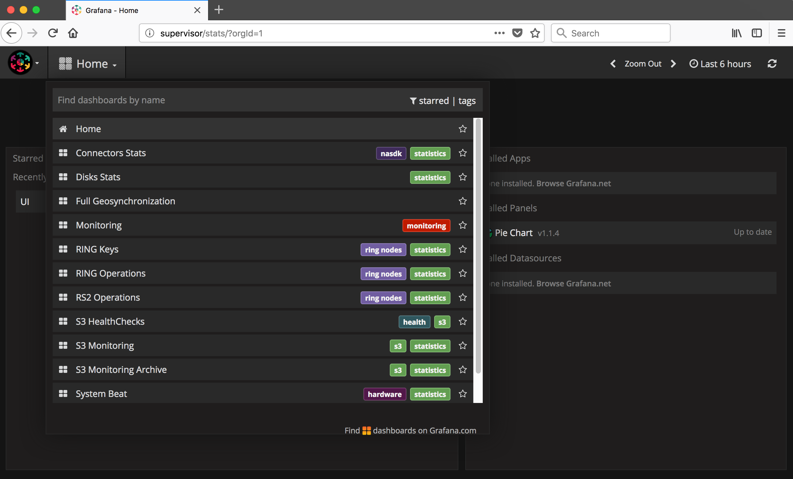
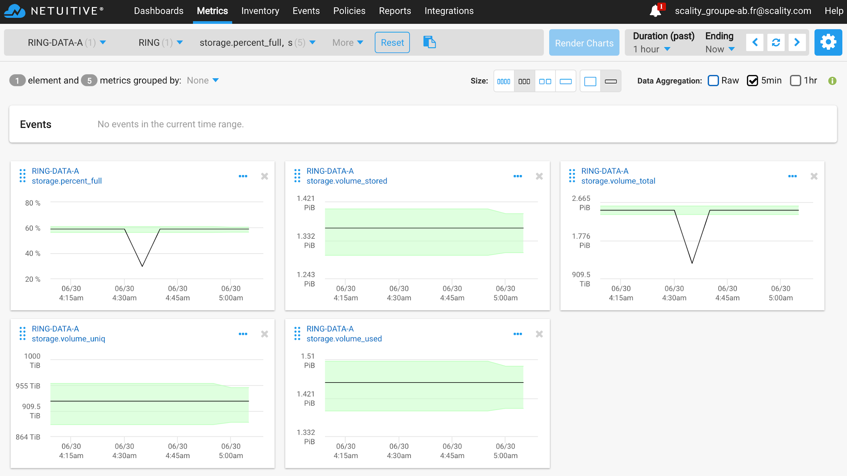
Monitoring (Demo)
Grafana and Cloud Monitor are covered in the Monitoring & Alerting module

Slide 10
GUI Admin Password Change
Although during the installation the same admin password is set across the board, there are actually four different passwords:
SupAPI (Supervisor GUI),
RING Administration Interface,
Grafana,
S3 Console.
The password change procedure depends on the RING version: look up “Changing supervisor Password” in the Scality RING Operations Guide on 🔗https://documentation.scality.com.
For other versions or the S3 Console Super Admin password, create a P3 support ticket.

Slide 11
Training Labs
Architecture overview and Access

Slide 12
Lab Assignments
 | User | Address1: Management | Address2: Service endpoint
Lab 01 | SGHKEU2-PL | pl.sghkeu2.eu.es.scality.com | s3-pl.sghkeu2.eu.es.scality.com
Lab 02 | SGHKEU2-DY | dy.sghkeu2.eu.es.scality.com | s3-dy.sghkeu2.eu.es.scality.com
Lab 03 | SGHKNA3-JT | jt.sghkna3.na.es.scality.com | s3-jt.sghkna3.na.es.scality.com
Lab 04 | SGHKNA3-JH | jh.sghkna3.na.es.scality.com | s3-jh.sghkna3.na.es.scality.com
Lab 05
Lab 06
Lab 07
Lab 08

Slide 13
Lab Credentials
SSH:
User: root
Two authentication options:
Private key authentication: see next slides.
Password authentication*: <root_password>
Supervisor GUI:
User: admin
Password: scality

Slide 14
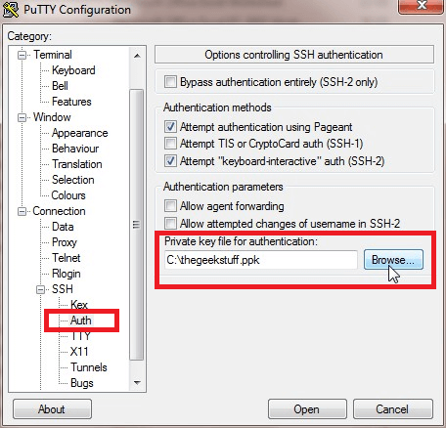
Lab Access from Microsoft Windows (PuTTY)
Download (or request) and save the lab’s 🔗PuTTY Private Key (PPK).
Open PuTTY (download 🔗here if necessary).
On the left panel, click on the “+” of +Connection.
Click on the “+” of +SSH to unveil the SSH configuration menu.
Click on Auth;
On the right, select the saved PPK key in “Private key file for authentication”.
On the left, go back up and click on Session;
Enter root@<Address1>, in “Host Name (or IP address)”.
Enter a name for the session in “Saved Sessions” and click Save to be able to easily re-connect.
Click Open to connect.
You then will be able to SSH to any lab server from the Supervisor.

Slide 15
Lab Access from MacOS or Linux Terminal
Download (or request) and save the lab’s 🔗RSA private key.
Open a terminal and change the key permissions to 600:
Start a SSH connection with the following information:
Host: Address1
Port: 22 (default)
User: root
RSA Private Key: saved RSA Key file
E.g:
You then will be able to SSH to any lab server from the Supervisor.
chmod 600 <path_to_the_saved_rsa_key_file>
ssh -i <path_to_the_saved_rsa_key_file> root@<Address1>

Slide 16
Exercise
Test your lab Web access to:
The Supervisor GUI,
The RING Administration Interface,
Grafana,
The S3 Console.
Test your SSH access to the Supervisor.

Slide 17

Lab Overview
S3 Endpoint: Address2 (see next slide)
DC1
dc1-store-1
load- balancer (lb)
@
dc1-store-0
supervisor
dc1-store-2
Management: Address1 (see next slide)
DC2
dc2-store-0
scality.cloud
dc2-store-1
dc2-store-2
CentOS 7.8
2x 10G SSD
4x 20 GB SATA

Slide 18
Customer Architecture
RING 8.5

Slide 19
Customer Internal Documentation
WHERE IS YOUR SCALITY INTERNAL DOCUMENTATION ?
DOES EVERY ATTENDEE HAVE ACCESS TO IT?
Notes:
“Having access to information and sharing it are critical to successful platform operations”- CK

Slide 20
Whiteboard Exercise: Rules
In turn, the attendees go to the whiteboard and fill in the specifications in the next slide.
The designated attendee can ask for information from the other attendees.
The instructor chooses when to name a new designated attendee.
The leaving designated attendee chooses the new designated attendee.
The instructor shares the Customer Architecture Document if needed.
Notes:
For remote trainings, you can use this spreadsheet (copy first): https://docs.google.com/spreadsheets/d/1Y3p3UpY9SGPFH2w37bxkq4rMFyGHnniGaFQ97i7ux9E/edit?usp=sharing

Slide 21
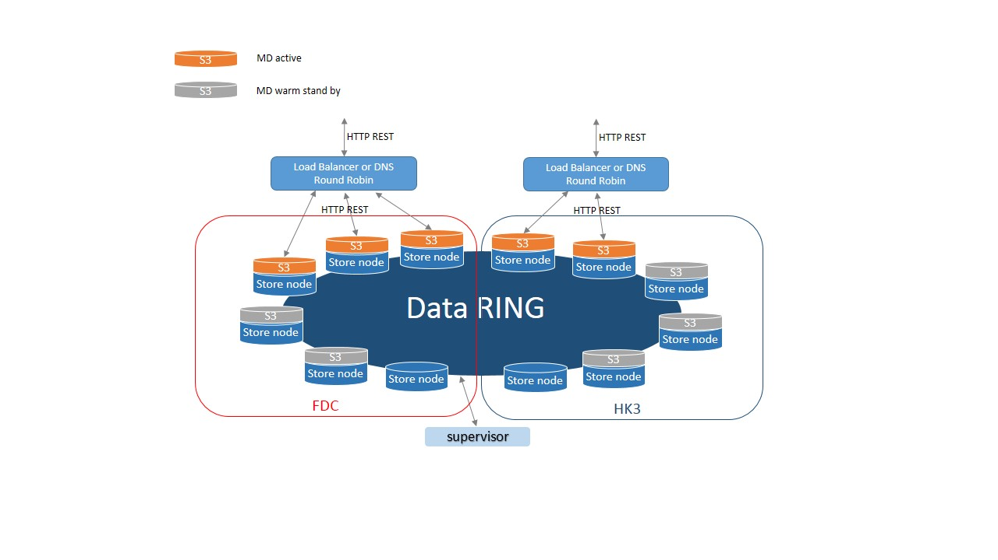
Implemented architecture
Notes:
“Having access to information and sharing it are critical to successful platform operations”- CK

Slide 22
Whiteboard Exercise: Platform Specifications
Hardware:
2 sites
storage servers: 2 * 6 servers HPE Apollo 4200 Gen9 20 CPU 128GB.
Disks : Data 18 * 6TB with P840ar RAID card + SSD 2 * 960 GB
Supervisor: VM or HW, brand and model, RAM, CPU, OS disks, NICs.
System: Redhat
Software:
S3
Dual site (WSB on minority)
RING version 7.4.2
data protection: ARC 5+7, cos3
Notes:
For remote trainings, you can use this spreadsheet (copy first): https://docs.google.com/spreadsheets/d/1Y3p3UpY9SGPFH2w37bxkq4rMFyGHnniGaFQ97i7ux9E/edit?usp=sharing

Slide 23

QUESTIONS ?

